Slide 1
UNIT-IV Traffic Management Techniques

Slide 2
Overview of topics
Integrated safety improvement and Traffic Calming Schemes,
Load limits (Enforcement)
Parking, Parking enforcement and its influence on Accidents
Travel Demand Management; Methods of Traffic management measures: Restriction of Turning Movements, One-way streets, Tidal Flow Operation Methods, Exclusive Bus Lanes and Closing Side-streets
Latest tools and techniques used for Road safety and traffic management
Road safety issues and various measures for road safety; Legislation, Enforcement, Education and Propaganda,
Air quality, Noise and Energy Impacts
Cost of Road Accidents
Highway lighting, red light camera (Safety cameras)
Tests on driver and vehicles,
Pedestrian safety issues,

Slide 3
Integrated safety improvement
Road safety engineering measures Typical examples:
Single site treatment
– improved signing
– carriageway markings
– road surface treatment
– lighting improvements
– alterations to alignment, kerbs and islands
– introduction of signal control or mini-roundabouts.
Mass action plan
– lighting improvements
– anti-skid surfacing
– speed enforcement cameras
– red-light running cameras
– pelicans, zebras and pedestrian phases at signals.

Slide 4
Road safety engineering measures Typical examples:
Route action plan
– carriageway widening at junctions
– speed limits
– speed control measures
– side road closures or left-in, left-out only
– cycle routes.
Area action plan
– vertical deflection – humps and tables
– horizontal deflection – chicanes and narrowings
– mini-roundabouts
– road entry treatment
– road closures and banned turns
– 20 mph zones

Slide 5
Traffic calming Schemes
Traffic calming has two main objectives: the reduction in numbers of personal injury accidents and improvement in the local environment for people living, working or visiting the area.
Traffic calming techniques can be broken down into eight broad categories:
legislation and enforcement
surface treatment and signing
vertical deflection
horizontal deflection
gateways and entry treatment
20 mph zones
home zones
lorry control schemes.

Slide 6
Effect of Speed and Load on Road Safety
The effect of excessive speed on road safety has been clearly identified. For some time, it has been recognised that a reduction of 1 mph in average road speeds can be expected to cause a reduction of 5% in accident frequency.
The excessive load of vehicles can damage pavements, chances of vehicle breakdown, excess on road space occupancy. Poses risk of accidents

Slide 7
Factors Influencing Travel Demand
Three factors that influence the demand for urban travel are:
Location and intensity of land use
Socioeconomic characteristics of people living in the area and
Extent, Cost, and Quality of available transportation services
Transportation System Management (TSM)
TSM is a planning and operating process designed to conserve resources and energy and to improve the quality of urban life.
All existing transportation facilities are viewed as elements of a single system; the objective is to organize these elements into one efficient, productive, and integrated transportation system

Slide 8
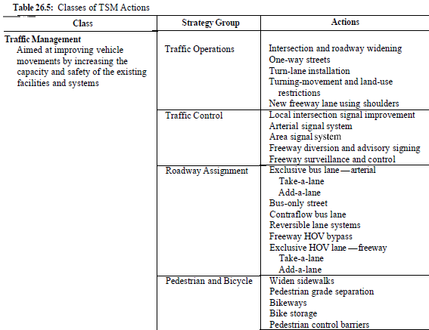
Transportation System Management (TSM)

Slide 9
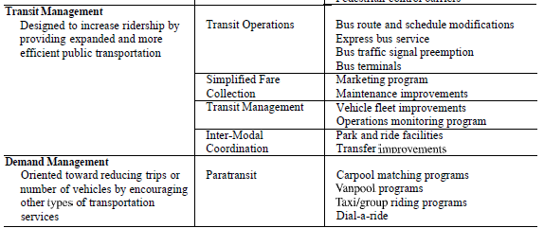

Slide 10
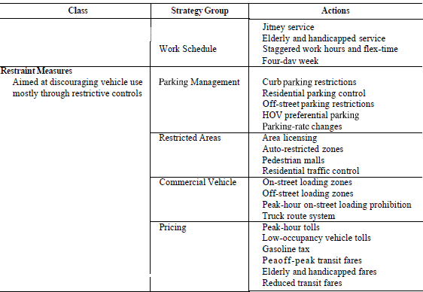

Slide 11
Traffic management
Regulatory measures for traffic management
It has its basis in law, and uses mandatory and prohibitory traffic signs and markings
Regulatory measures include
Speed limits
Restrictions on turning movements
Closure or one-way operation of streets
Tidal-flow operation of major roads
Priority for high occupancy vehicles (Exclusive bus lanes),
Reversible lanes, and
On-street waiting restrictions and parking control

Slide 12
Regulatory measures Speed limits
Two types of speed limit are in use throughout the world
Absolute speed limit is that above which it is illegal to drive, irrespective of the traffic, roadway, weather, or other conditions prevailing. This type of limit is preferred by enforcement police
Prima facie speed limit is that above which motorists are assumed to break the law; however, they may argue in court that their speed was safe for the conditions prevailing at the time. This is a flexible limit in that police can adjust their enforcement according to their view as to whether the conditions prevailing are safe; however, it relies on the police to use judgement as to what is safe, and this is more easily challenged in the courts

Slide 13
Speed limit Factors
Factors which should be taken into account when establishing a speed limit include
Design speed of road,
Prevailing vehicle speeds,
Road cross-section,
Curvature,
Gradient and quality of surfacing,
Frequency and spacing of intersections,
Traffic volume and composition,
Accident history,
Presence of pedestrians/parking vehicles and
Traffic control devices that affect vehicle speeds

Slide 14
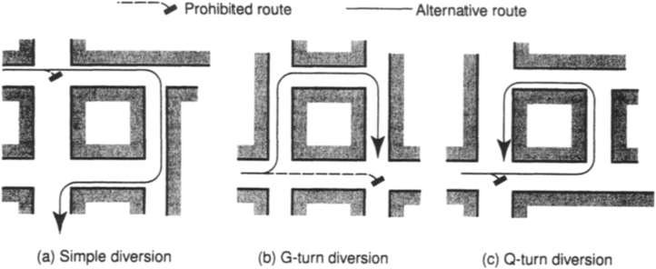
Restrictions on turning movements
Congestion and accidents caused by right-turning vehicles at signal-controlled intersections are usually coped with by inserting an extra phase or early cut-off and late start arrangements in the signal cycle
In some instances it may be preferable to ban right-turning vehicles at a critical intersection during all or part of the day, rather than attempt to provide directly for this movement.

Slide 15
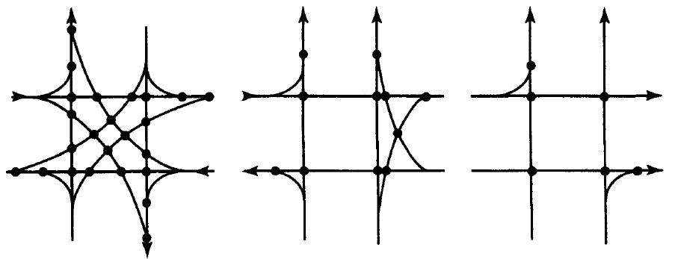
One way streets
One-way traffic operation is a simple regulatory tool available for the relief of traffic congestion. Its most effective usage is on streets in and about the central areas of towns
Potential points of conflict at an intersection”
two 2-way streets, 24 conflicts
One 1-way & one 2-way street, 11 conflicts
two 1-way streets, 6 conflicts

Slide 16
Advantages of One-way Street Systems
General Benefits:
Improved ability to coordinate traffic signals
Removal of opposed left turns
Related quality of flow benefits such as increased average speed and decreased delays
Better quality of flow for bus transit; lower transit operating costs
Left-turn lanes not needed
More opportunity to maneuver around double-parked or slow-moving vehicles
Ability to maintain curb parlung longer than otherwise possible (due to capacity benefits)
Capacity Benefits:
Reduced left-turn pces
Fewer signal phases (at signalized intersections)
Reduced delay
Better utilization of street width
Safety Benefits:
Intersection LT conflicts removed
Midblock LT conflicts removed
Improved driver field of vision

Slide 17
Disadvantages of One-way Street Systems
Increased trip lengths for some/most/all vehicles, pedestrians, and transit routes
Some businesses negatively affected
Signal coordinated in grid still poses closure problem
Transit route directions now separated by at least one block
For transit routes, a 50% reduction in right-hand lanes; may create bus stop capacity problem
Concern of businesses about potential negative impacts
Fewer turning opportunities
Additional signing needed to designate “one-way” designations, turn prohibitions, and restricted entry

Slide 18
Tidal-flow operation of major roads
It is a traffic management tool whereby the total carriageway width is shared between two directions of travel in near proportion to the flow in each direction
The number of lanes assigned to each direction of travel varies with the time of day so that extra capacity is provided to the heavier traffic flow during, typically, peak commuter periods
The great advantage of tidal-flow operation is that extra capacity is provided on the same road at the time required and, unlike one-way streets, traffic in the minor direction does not have to move to a complementary street
Its usage is particularly applicable to heavily trafficked bridges, tunnels and radial roads in urban areas

Slide 19
Disadvantages of tidal-flow schemes
Implementation can be expensive
Poor implementation can result in increasing numbers of head-on accidents
Central pedestrian refuges have to be removed
No-parking restrictions are normally imposed
Right turns from minor roads may have to be banned
Bus stops and laybys may have to be removed if single lanes are used to carry the minor flow
This type of operation normally cannot be applied to roads divided by central reservations.

Slide 20
Priority for High Occupancy Vehicles (HOV)
The use of HOV facilities, which focus on increasing the person-movement efficiency of a road or travel corridor is aimed at addressing traffic congestion and environmental concerns as well as reducing the delays to buses and increasing their reliability.
A variety of HOV treatments are currently in operation worldwide; they include
Busways on separate rights of way,
Exclusive lanes, and
Priority for HOVs at intersections.
HOV facilities that are open to private car pools as well as public buses are prevalent in North America, whereas elsewhere in the world (including Britain) the emphasis is on bus usage. However, in Britain access to HOV operation is often given to taxis (and emergency vehicles) and sometimes to cyclists and disabled drivers

Slide 21
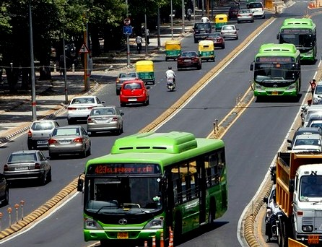
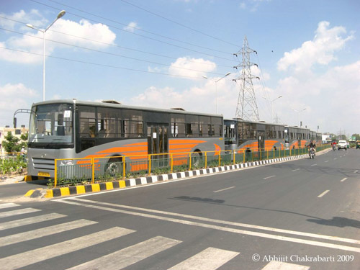

Bus Rapid Transit (BRT)

Slide 22
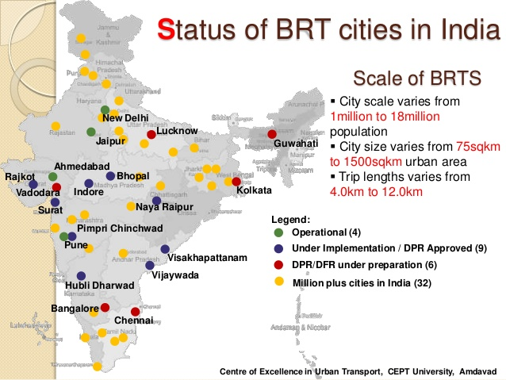
Bus Rapid Transit (BRT) System
By 2003 Delhi (India) got into process of adopting BRTS to Indian cities.
BRTS planning was followed by Ahmedabad (2005), Pune and Indore (2006).

Slide 23
Vehicle Parking
Terminal facilities form an integral part of any transportation system
Failure to provide suitable parking facility can result in congestion and frustration
As a general rule increase in vehicle ownership results in increased parking demand
The availability of less space in urban areas has increased the demand for parking space especially in areas like Central business district (CBD). This affects the mode choice also. This has a great economical impact

Slide 24
On-street parking-ill effects
Congestion:
Parking takes considerable street space leading to the lowering of the road capacity. Hence, speed will be reduced, journey time and delay will also subsequently increase. The operational cost of the vehicle increases leading to great economical loss to the community.
Accidents:
Careless maneuvering of parking and unparking leads to accidents which are referred to as parking accidents. Common type of parking accidents occur while driving out a car from the parking area, careless opening of the doors of parked cars, and while bringing in the vehicle to the parking lot for parking.
Environmental pollution:
They also cause pollution to the environment because stopping and starting of vehicles while parking and unparking results in noise and fumes. They also affect the aesthetic beauty of the buildings because cars parked at every available space creates a feeling that building rises from a plinth of cars.
Obstruction to fire fighting operations and other emergency services:
Parked vehicles may obstruct the movement of fire fighting vehicles. Sometimes they block access to hydrants and access to buildings

Slide 25
Purpose of parking studies
To determine the congestion in the city/town areas
To assess the suppressed parking demand
To evaluate capacity of the existing parking facilities
To estimate the desires and demands of the public for parking facility
To decide the capacity, location and type of future parking facilities
Methods of Parking Surveys
In-out survey
Fixed period sampling
License plate method of survey

Slide 26
Parking surveys
In-out survey:
In this survey, the occupancy count in the selected parking lot is taken at the beginning. Then the number of vehicles that enter the parking lot for a particular time interval is counted. The number of vehicles that leave the parking lot is also taken. The final occupancy in the parking lot is also taken
Here the labor required is very less.
Only one person may be enough. But we wont get any data regarding the time duration for which a particular vehicle used that parking lot. Parking duration and turn over is not obtained. Hence we cannot estimate the parking fare from this survey

Slide 27
Parking surveys
Fixed period sampling:
This is almost similar to in-out survey. All vehicles are counted at the beginning of the survey. Then after a fixed time interval that may vary between 15 minutes to 1 hour, the count is again taken. Here there are chances of missing the number of vehicles that were parked for a short duration

Slide 28
Parking surveys
License plate method of survey:
This results in the most accurate and realistic data
In this survey, every parking stall is monitored at a continuous interval of 15 minutes or so and the license plate number is noted down.
This will give the data regarding the duration for which a particular vehicle was using the parking bay.
This will help in calculating the fare because fare is estimated based on the duration for which the vehicle was parked.
If the time interval is shorter, then there are less chances of missing short-term parkers. But this method is very labor intensive

Slide 29
Parking Requirements
Minimum parking requirements for different types of buildings.
Residential plot area less than 300 sq.m: only community parking space.
from 300 to 500 sq.m, 1/3rd of the open area
from 500 to 1000 sq.m, 1/4th of the open area
above 1000 sq.m, 1/6th of the open area
Flats (apartments): 1space for every 2dwellings (50-100sq.m)
Multistoried group housing:1space for every 4dwellings
Offices: 1 parking space for every 70 sq.m.
Shops & markets: 1 parking space for every 80 sq.m.
Restaurants: 1 parking space for every 10 seats
Hotels and motels
Five/Four star hotels: 1parking space for every 4 guest rooms
Three star hotels: 1parking space for every 8 guest rooms
Two star hotels: 1parking space for every 10guest rooms
Motels: : 1parking space for each guest room
Theatres and cinema halls need to keep only 1 parking space for 20 seats.
Hospitals: 1parking space for every 10beds

Slide 30
Parking types
Parking facilities may be broadly divided into two types
On street/Kerb parking
vehicles are parked on the sides of the street itself
Usually controlled by government agencies
As per IRC the standard dimensions of a car is taken as 5.0X2.5m and that for a truck is 7.5X3.75m
Parallel parking: The vehicles are parked along the length of the road. It is the most safest parking from the accident perspective, it consumes the maximum curb length and therefore only a minimum number of vehicles can be parked for a given kerb length and produces least obstruction to the on-going traffic
30, 45, 60, 90 deg. parking:

Slide 31
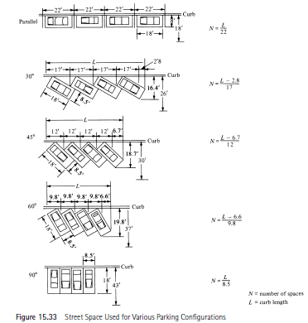

Slide 32
Off-street parking
These facilities may be privately or publicly owned; they include
Surface lots and
Garages.
Self-parking garages require that drivers park their own automobiles;
Attendant-parking garages maintain personnel to park the automobiles.

Slide 33
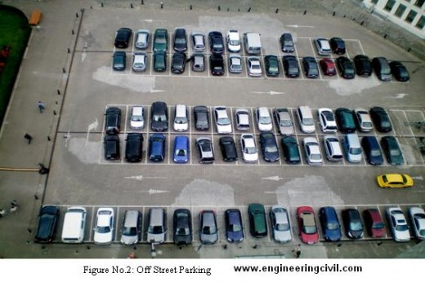
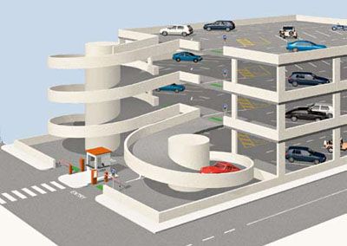
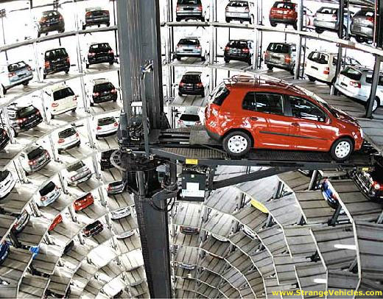
Off-street parking
Surface lots
Elevated Parking
Mechanized Elevated Parking

Slide 34
Intersection types
Un controlled intersections at grade
Intersection with priority control
No delay in major street
Minor street with “Give way” or “Stop” signs
Time separated intersections (signalized)
Major street: Both directions traffic 650-800PCU/hr
Minor street: one direction traffic 200-250PCU/hr
Space separated intersections (grade separated)
Total traffic volume > 10,000 PCU/hr

Slide 35
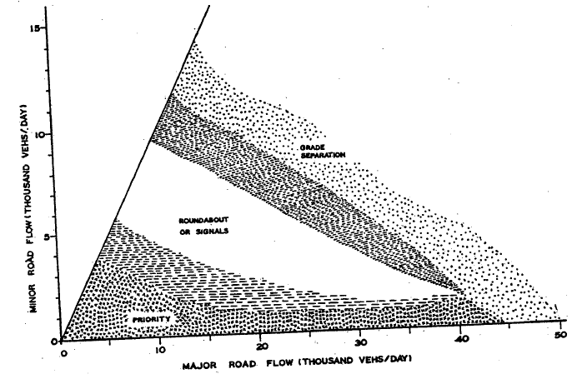
Intersection selection based on traffic flow

Slide 36
Intersection Control
The purpose of traffic control is to assign the right of way to drivers and thus to facilitate highway safety by ensuring the orderly and predictable movement of all traffic on highways
Control may be achieved by using
Traffic signals, Signs, or markings that regulate, guide, warn, and/or channel traffic
Different types of intersection control are
Yield Signs, Stop Signs, Multiway Stop Signs, Intersection Channelization, Traffic Signals

Slide 37
Minimize Conflict Point (CP)
Any location with Merging, Diverging or Crossing maneuvers of two vehicles is a potential conflict point (CP)
Minimize severity and no.of conflict points by
Space separation by access control islands through channelization
Time separation by traffic signals on waiting lanes

Slide 38
Methods to Minimize Conflict Points
Convert a 4-Armed Intersection (32CP) to a Round-About (12CP)
Signalize intersection:
Introduction of two phase signal reduces 32CPs to a 12CPs in a 4-Armed Intersection
If more phases introduced all CPs can be eliminated
Channelizing the directional traffic by selective use of channelizing islands and medians
Changing priority of crossing
Staggering a 4-Armed junction by flexing two opposing arms and create two T-Junctions

Slide 39
Measures to Enhance Safety at Intersections
By eliminating highly trafficked side road connections
In rural sections upto 30% reductions in accidents possible
By converting lightly trafficked cross road into properly designed staggered junction
60% reduction in accidents possible
In urban areas control of access, street parking and development in the vicinity of intersection improves the safety considerably

Slide 40
5Es to Road safety
Road safety is result of effective measures and their integration in the areas of
Engineering (Roads)
Engineering(Vehicles)
Enforcement
Education
Emergency

Slide 41
5Es to Road safety
Engineering (Roads)
Road Design and Maintenance
Segregation of traffic
Lighting system
Speed
Double white lines
Alignment
Road Surface
Margins
Engineering (Vehicles)
Vehicle Design and maintenance

Slide 42
5Es to Road safety
Enforcement
Speed control
Traffic control
Training and supervision
Medical check
Compulsion to wear Helmet, seat belt
Education
Road users (pedestrians, drivers) training, education
Traffic rules, traffic safety week programs etc.
Emergency
Rs 14,000 cr to be spent to cut road accidents-11.07.2019 https://www.socialnews.xyz/2019/07/11/rs-14000-cr-to-be-spent-to-cut-road-accidents/

Slide 43
Highways and Traffic Effect on Environment
Issue of Transportation and Environment is paradoxical in nature
Environmental Impact Assessment (EIA) of a highway scheme discusses in detail the effects on various components of the environment
Consider “do nothing” alternate compare beneficial and adverse effects of the proposed scheme
Most important impacts of transport on the environment relate to
Climate change, Air quality, Noise, Water quality, Soil quality Biodiversity and Land take

Slide 44
Highways and traffic Effect on Environment - Climate Change
Transport industry activities release several million tons of gases each year into the atmosphere.
These include Lead (Pb), carbon monoxide (CO), carbon dioxide (CO₂), methane (CH₄), nitrogen oxides (NO_{x}), nitrous oxide (N₂O), chlorofluorocarbons (CFCs), perfluorocarbons (PFCs), silicon tetraflouride (SF₆), benzene and volatile components (BT_{X}), heavy metals (zinc, chrome, copper and cadmium) and particulate matters (ash, dust)
Some of these gases, particularly nitrous oxide, also participate in depleting the stratospheric ozone (O3) layer
Climate change also has a significant impact on transportation systems, particularly infrastructure

Slide 45
Highways and traffic Effect on Environment - Air Pollution
The excessive concentration of foreign matter in the air which adversely affects the well being of the individual or causes damage to property is Air pollution
Pollutants and Sources of Air pollution
Smog (smoke+fog)
Photochemical smog (air stagnation, abundant sunlight, high concentrations of hydro corbons and Nox)
Stationary sources (plant chimneys)
Mobile sources (highway vehicles, trains, vessels, Aircrafts)
Vehicles are the sources of Air pollution in the form of gas and particulate matters emissions that affects air quality causing damage to human health

Slide 46
Highways and traffic Effect on Environment - Air Pollution
Toxic air pollutants are associated with cancer, cardiovascular, respiratory and neurological diseases
Carbon monoxide (CO) when inhale affects bloodstream, reduces the availability of oxygen and can be extremely harmful to public health
Nitrogen dioxide (NO2) reduces lung function, affects the respiratory immune system and increases the risk of respiratory problems
Sulphur dioxide (SO2) and nitrogen oxides (NOx) in the atmosphere form various acidic compounds that when mixed in cloud water creates acid rain. Acid precipitation has detrimental effects on the built environment, reduces agricultural crop yields and causes forest decline. The reduction of natural visibility by smog has a number of adverse impacts on the quality of life and the attractiveness of tourist sites
Particulate emissions in the form of dust emanating from vehicle exhaust associated with health risks such as respiratory problems, skin irritations, eyes inflammations, blood clotting and various types of allergies.

Slide 47
Automobile emission control
Control of crankcase emissions
Control of exhaust emissions
Control of Evaporation emissions
Alternatives to the gasoline engines
Strict implementation of legislations

Slide 48
Highways and traffic Effect on Environment - Noise Pollution
Noise represents the general effect of irregular and chaotic sounds
Main Sources of Noise Pollution: Automobile, Aeroplanes, Trains, construction works, loud speakers
One of the major hazards of modern life especially in urban areas- areas which are the most industrialized, urbanized and motorized
It is traumatizing for the hearing organ and that may affect the quality of life by its unpleasant and disturbing character. Long term exposure to noise levels above 75dB seriously hampers hearing and affects human physical and psychological wellbeing
Transport noise emanating from the transport vehicles and the operations of ports, airports and rail yards affects human health, through an increase in the risk of cardiovascular diseases. Increasing noise levels have a negative impact on the urban environment reflected in falling land values and loss of productive land uses

Slide 49
Cost of Road Accidents
Road accidents cause huge economic loss to society by way of
loss of output by fatal and injured victims;
expenses incurred in medical treatment;
administrative costs of police,
insurance companies and accident claims tribunals; and
damages to vehicles and property.
Apart from these tangible components, intangible costs such as
pain, grief and suffering are also caused.
An accurate understanding of the monetary costs of accidents of various types helps transportation planners and economists to account for this component of road user cost while undertaking an economic appraisal of highway schemes.

Slide 50
The important uses of accident cost
To estimate the problem of accident in economic terms.
Formulate safety standards keeping in view that the cost of the facility- construction vis-àvis.
Calculation of actual level of investment / expenditure on road safety administration
Improvement of road safety and its impacts on economic provisions.
To include the accident cost as a part of road transport budget
Calculation of national loss due to accident.

Slide 51
Methodologies for accident cost prediction
six methodologies for accident cost prediction and accident reduction
The Gross output or human capital approach.
The Net Output approach.
The Life insurance approach.
The Court award approach.
The Implicit public sector valuation approach.
The values of risk-change approach.

Slide 52
Accident cost
Accident cost = PCC + RC + PSC
PCC = Personal capital cost = Life period lost * average income or = (Life period lost * average income) – (Future consumption) or = Value of willingness to insure the life or = court award for accident or = Lx * E – Lx * C
Where, Lx= Life expectancy at age x: x being the average age of accident victim; E = Earning at age x; C = Consumption at age x
PSC = Personal Suffering cost (A National value based on value judgment)
RC = Resource cost = (Road damage + Vehicle damage + Court and medical expenditure and other overheads)

Slide 53
The Factors influencing Cost of Accidents
Ref. K. NACHIMUTHU AND P. PARTHEEBAN (2013) ECONOMIC ANALYSIS OF ROAD ACCIDENT COST FOR CHENNAI CITY, INDIA Article in Pollution Research · January 2013

Slide 54
Roadway lighting
The general purpose of roadway lighting is to provide improved safety, security, and aesthetics for the various users of the roadway and associated facilities. Lighting enables the driver to recognize the geometry and condition of the roadway at extended distances, thereby simplifying the driving task at night. This, in turn, increases driver visual comfort and reduces driver fatigue, which contributes measurably to highway safety.
The lighting can help drivers be aware of their surroundings and provide well-illuminated safety for pedestrians.
Roadway lights can also enhance the overall design of a road and the surrounding buildings. One of the lighting industry’s changing trends in roadway lighting is the switch to LED.
LED highway luminaires can provide high energy cost savings, little to no maintenance, lighting control, and less light pollution

Slide 55
Warrants for Highway Lighting (need for lighting)
Facilities with Raised Medians
Major Urban Arterials
Intersections
High-Conflict Locations
Complex Roadway Geometry
Night-to-Day Crash Ratio
Local Agency Needs
Pedestrian Sidewalks
Rest Areas
Bridge Structures and Underpasses
weighing area, parking areas, speed change lanes, ramps

Slide 56
Tests for a vehicle at Fixed Inspection Lanes or Mobile Inspection Lanes
Pollution Test (Opacity test for Diesel version and Gas analyzing for petrol version)
Alignment Test (Side slip plates)
Headlight Test
Sound Test / Noise Test
Speedometer test
Brake test for multiple axles
Suspension Test (for LMV)
Joint Play test
Visual Check
Ref. Inspection & Maintenance Station (IMS) Under National Institute for automotive Inspection, Maintenance and Training (NIAIMT) Implemented under NATRiP, Under Ministry of Heavy Industry, Govt. of India

Slide 57
Tests for a Driver
Tests for Visual Functions
Visual acuity, which is commonly tested.
Contrast sensitivity, which is significant, but rarely tested.
Visual field, for which requirements vary and testing methods are rarely specified.
Other visual functions include: glare sensitivity, Useful Field of View (UFOV), diplopia, color vision and night vision.
Driving Licence Test / Driving Skills / “Behind-the-Wheel” Test

Slide 58
Vision that affect driving
Distance vision: The ability to see clearly is essential for safe driving. Even the simplest reactions can take 0.4 seconds. If distance vision is poor, hazards may not be seen until it is too late to react safely. For example, it takes four times as long to stop from a speed of 80 km/h as it does from 40 km/h. This means the faster you travel, the less time you have to see things and react to them. Poor distance vision and excessive speed increase the risk of making unreliable judgements, with potentially disastrous results. Distance vision can also be affected by the state of your windscreen and glasses. These should be kept clean and free of dust and scratches, which can greatly reduce vision on bright days and at night. Scratched sunglasses should not be worn when driving.
Accommodation (near vision focusing): A driver needs to look from the road to the dashboard and back again quite frequently. This ability to change focus from far to near is called accommodation. Over the age of 45, most people have gradually increasing difficulty with near vision, and may require glasses to see dashboard instruments clearly.
Field of vision (peripheral): The ability to see to both sides is particularly important for the early recognition of cross-traffic, pedestrians and animals at the roadside, without having to look away from the road ahead. Your optometrist, ophthalmologist or GP can show you a simple method of self-checking your field of vision. Make the best use of your side and rear view mirrors, and keep them adjusted correctly.

Slide 59
Vision that affect driving
Depth perception: Passing other vehicles and changing lanes requires good judgement of distance, especially in busy traffic. A person with good eyesight has the most reliable depth perception. Drivers who have recently lost the use of one eye need to take extra care. They may need to stop driving for a period of time until their vision has adjusted.
Night vision: Night vision requires the ability to see in low and variable light conditions. It also requires an ability to recover quickly from the glare of oncoming headlights. Glare recovery is best in drivers under the age of 30, and night vision can deteriorate after the age of 40. Drivers over 40 should compensate to some extent for this reduction in the quality of night vision by driving more slowly. Eyes are much slower to adapt to night-time light levels following exposure to bright light. Being outdoors in the sun for only a few hours can slow the dark adaptation process so that normal night vision may not be reached for several hours after dark. This temporary loss of night vision can be avoided if sunglasses are worn during the day. Some people find that their night vision has deteriorated and they can't drive safely at night at all. However, it is possible to get a licence which allows you to drive in daylight only.
Colour vision: Colour plays an important part in road safety. Drivers must instantly recognise traffic lights, indicator signs, hazard warning lights and stop lights, and people with colour vision defects may be slower in reacting to them. Avoid the use of medium or dark blue sunglasses which can seriously interfere with some people's ability to distinguish traffic light colours.

Slide 60
Pedestrian safety issues
More pedestrian deaths is the result of a collision with a vehicle at an intersection
Pedestrian safety problems can occur at intersections for a variety of reasons, including the following:
Complex signal phasing or lack of traffic control at high-volume, high-speed and multi-lane intersections.
Limited or somewhat erratic compliance by motorists, even at simple STOP- or YIELD-controlled intersections
Pedestrian violation of traffic control devices, particularly in large urban centers.4 More than a quarter of fatal crashes involving pedestrians are the result of pedestrians disobeying intersection traffic control or making mis-judgments while attempting to cross a street
Low levels of enforcement for pedestrian and driver traffic control violations.
Auto-oriented signal timing. Traffic signal timings may be too short to permit safe intersection crossing. Assumptions of walking speeds for signal timing may be too fast for many pedestrians to cross to the other side of the curb. At the same, additional lanes to increase roadway capacity can also have a negative effect on signal timing and pedestrian safety if not properly applied
Poor understanding of pedestrian signal displays by pedestrians.

Slide 61
Pedestrian safety issues
Conflicts with turning vehicles. Data consistently show that crashes with pedestrians occur far more often with turning vehicles than with through traffic. Left-turning vehicles are more often involved in pedestrian collisions than right-turning vehicles, partly because drivers are not clearly able to see pedestrians on the left.
Wide crossings. Research indicates that increasing the lanes on a roadway from four to six or more lanes increases the percentage of fatalities represented by pedestrian crashes by 64 percent
Right-turns-on-red (RTOR) can potentially contribute to pedestrian crashes by creating conflicts between pedestrians and motorists. RTOR may also reduce pedestrian opportunities to cross intersections if motorists fail to yield the right-of-way to pedestrians.
Pedestrian visibility to drivers is worse during hours of darkness, especially in areas with poor pedestrian-scale lighting. This is a common shortcoming of rural and suburban intersections. Pedestrians generally perceive that they are visible to drivers well before the drivers can actually see them.

Slide 62
Pedestrian Safety Countermeasures
To address pedestrian safely problems at intersections, the possible pedestrian safety countermeasures within the following categories:
Crosswalk improvements
Intersection design/ physical improvements; and
Intersection operations and signal hardware/technology.

Slide 63



Slide 64
References
Traffic Engineering Design Principles and Practice 2nd edition Mike Slinn, Paul Matthews, Peter Guest
Transport Planning and Traffic Engineering by CA O'Flaherty et.al 2006
Traffic and Highway Engineering FOURTH EDITION by Nicholas J. Garber and Lester A. Hoel University of Virginia
IRC104
IRC SP19-2001
IRC SP 41
Ref. Inspection & Maintenance Station (IMS) Under National Institute for automotive Inspection, Maintenance and Training (NIAIMT) Implemented under NATRiP, Under Ministry of Heavy Industry, Govt. of India

